Slide 1
DESIGN (ANTI-)PATTERNS
Prototype

Slide 2
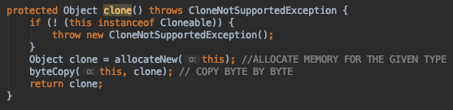
Clone method
Most simple way to create a prototype
Method is defined as native

Slide 3

Clone method
How to implement

Slide 4
Creational patterns
Factory method
Abstract factory
Builder
Singleton
Prototype

Slide 5
Prototype...
… offers more flexibility

Slide 6
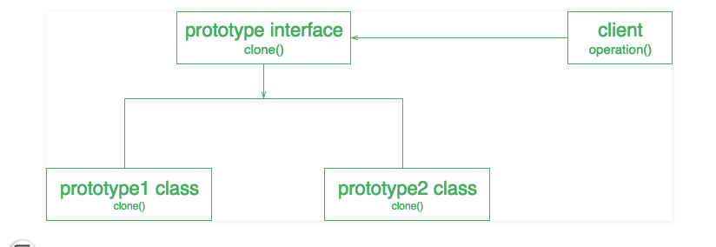
UML
… offers more flexibility

Slide 7
Usecase
When is prototype suitable
When object has hundreds fields and possible configurations, but in practice, we need to use only several configurations (pseudoclasses).
When your code works with objects passed to you from 3rd-party code via some interface.
To avoid building complex hierarchies of factories.

Slide 8
Prototype
Pitfalls
Circular dependencies of the objects to be cloned
Notes:
When writing an object pool, the programmer has to be careful to make sure the state of the objects returned to the pool is reset back to a sensible state for the next use of the object. If this is not observed, the object will often be in some state that was unexpected by the client program and may cause the client program to fail. The pool is responsible for resetting the objects, not the clients.
inadequate resetting of objects may also cause an information leak. If an object contains confidential data (e.g. a user's credit card numbers) that isn't cleared before the object is passed to a new client,
If the pool is used by multiple threads, it may need the means to prevent parallel threads from grabbing and trying to reuse the same object in parallel. This is not necessary if the pooled objects are immutable or otherwise thread-safe.

Slide 9
Prototype
References
Rudolf Pecinovsky – Navrhove Vzory https://refactoring.guru/design-patterns/prototype https://www.geeksforgeeks.org/prototype-design-pattern/ https://sourcemaking.com/design_patterns/prototype

Slide 10
Prototype
Questions and discussion

